Slide 1

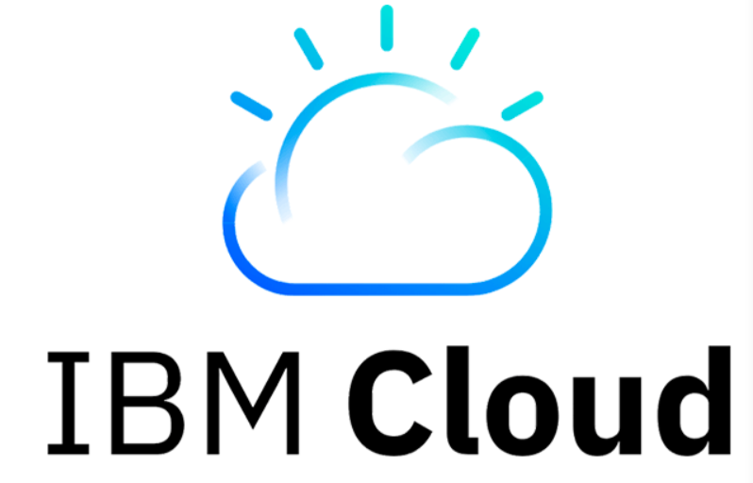

CloudOps
Team 3
ChAItanya Subhash
Srinija
Swaroop
Viswanth
Priyanka

Slide 2
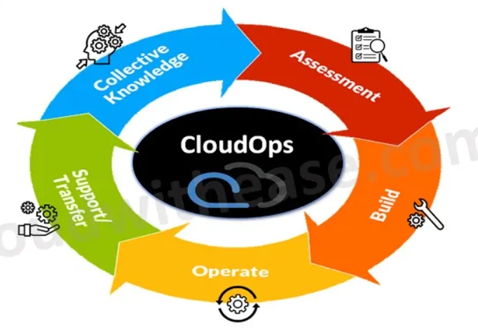
Introduction to CloudOps
Cloud operations (CloudOps) is the practice of managing delivery, tuning, optimization, and performance of workloads and it services that run in a cloud environment.
CloudOps uses analytics and data-driven insights to achieve
visibility into cloud environments.
Benefits:
cost effectiveness.
scalability.
automation.
disaster recovery.
continuous operations.
Challenges: Cost management, security risks, lack of visibility, compliance issues.

Slide 3
IBM CloudOps & Features
IBM cloud operations solutions leverage advanced technologies such as artificial intelligence (AI), automation, and hybrid cloud capabilities to address the complexities of modern IT operations.
Key Features:
AI driven operations (AIOps). [IBM Cloud Pak, IBM WatsonX, IBM Granite model]
Flexible Infrastructure. [supports Multicloud, Hybrid cloud, enables Containerization]
Hybrid Multicloud Management. [IBM cloud satellite, IBM hybrid cloud mesh]
Automation & Orchestration. [IBM cloud automation manager]
Security & Compliance [provides continuous monitoring, IAM, built-in controls for HIPAA, GDPR]
Real time visibility & Insights [IBM Instana, AI powered recommendations]
Scalability [IBM Turbonomic]
Integration & Ecosystem [integrates with 3rd party tools like OpenShift, Kubernetes via Open APIs]

Slide 4
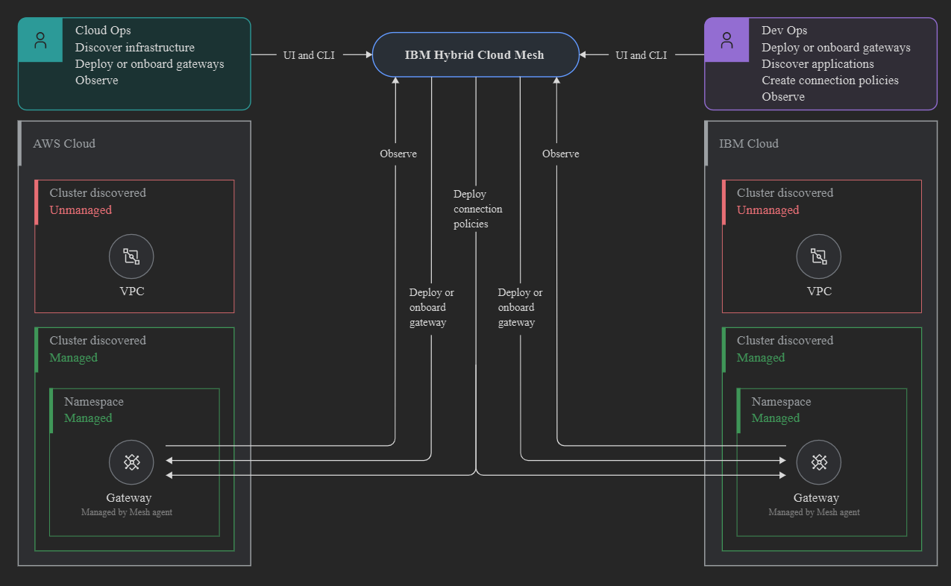
IBM cloudops Features (contd..)
IBM Hybrid Cloud Mesh is a Multicloud, application-centric, networking solution. it is designed to simplify connectivity and management across diverse cloud environments. it enables enterprises to use simple, scalable, seamless, and secure Hybrid Multicloud connectivity.

Slide 5
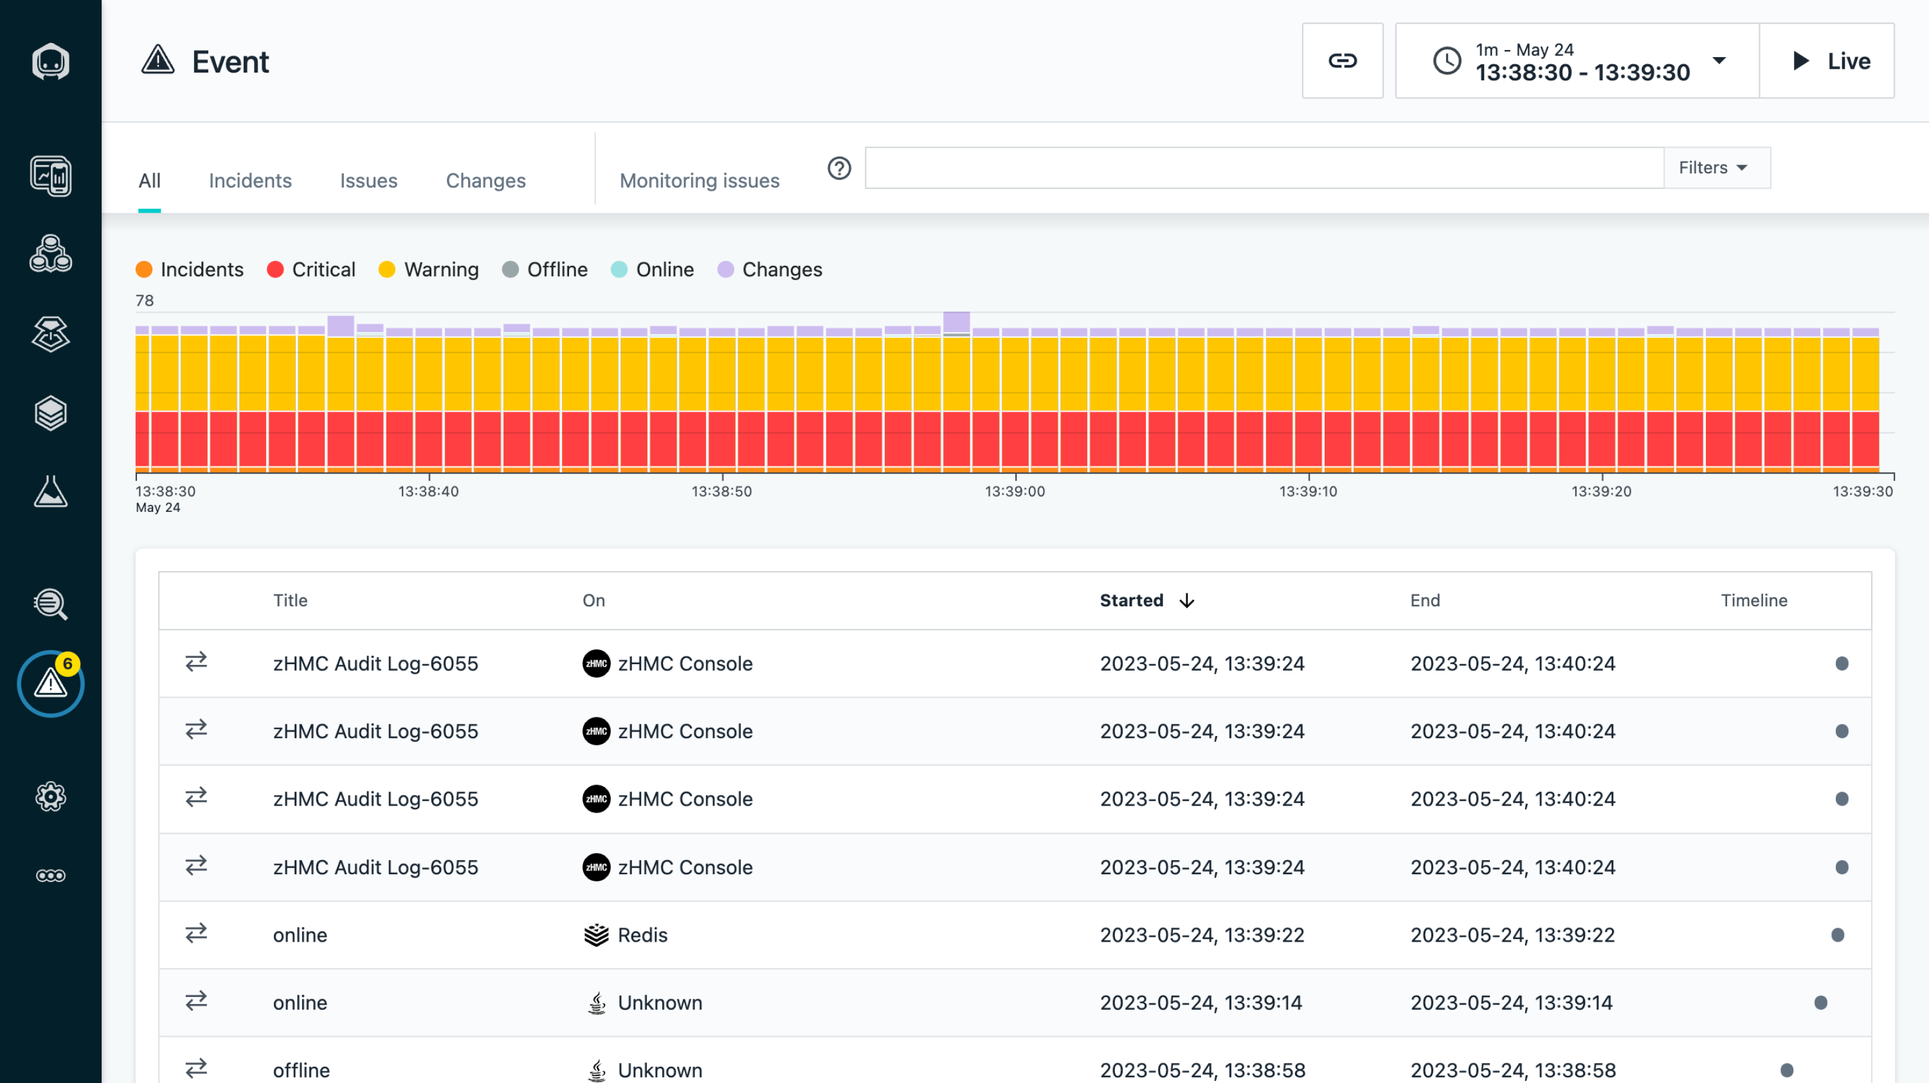
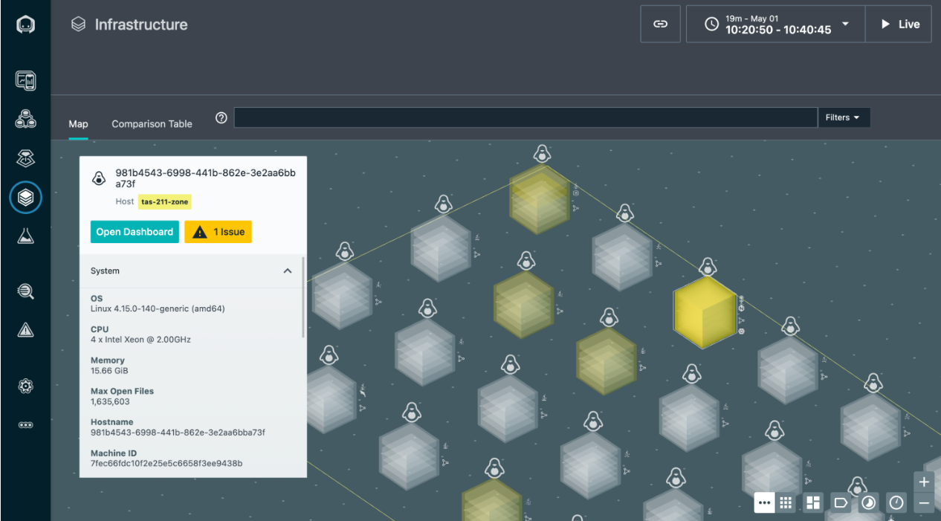
IBM cloudops Features (contd..)
IBM Cloud Satellite, IBM CloudPak for Watson AIOps, IBM Turbonomic etc., which focus on ai-driven automation, observability, cost optimization, security, and cloud management
IBM Instana : Instana automatically discovers and maps cloud deployments, root cause analysis of performance issues, Accelerate & Infrastructure monitoring.

Slide 6
IBM CloudOps Benefits
Increased efficiency in operations [ex: automation and AI-driven insights with IBM Cloud Pak for AIOps]
Cost optimization [using IBM cloud cost and asset management, pay as you go]
Improved performance and reliability [IBM cloud Kubernetes service with AIOps, IBM hybrid cloud mesh]
Increased innovation & Agility [Watson AI with IBM cloud operations, IBM Cloud Pak]
Simplified Hybrid Multicloud management [IBM cloud with Red hat OpenShift, IBM hybrid cloud mesh]
Stronger Security and Compliance [IBM cloud security and compliance center]

Slide 7
IBM CloudOps Use cases
Organizations are leveraging IBM hybrid cloud mesh for use cases like:
- Application upgrade
- Security enhancement
- Improved network performance
- Network connectivity.
Ex: Aliado Solutions: they leverage IBM’s suite of automation tools along with hybrid cloud mesh and ns1 to focus on three main aspects- automation and efficiency, enhanced flexibility, optimized performance & user experience.
Result: one of the client able to reduce their application deployment times by over 50% while improving their failover capabilities, managed to enhance their global application performance during peak shopping periods.

Slide 8
THANK YOU

